Slide 1

Department of Computer Engineering
Adder and Subtractor
1

Slide 2
Points covered
Department of Computer Engineering
Half adder
Full adder
Half Subtractor
Full Subtractor
Quiz
2

Slide 3
Department Vision & Mission
Department of Computer Engineering
Vision
Achieve academic excellence through education in computing, to create intellectual manpower to explore professional, higher educational and social opportunities.
Mission
To impart learning by educating students with conceptual knowledge and hands on practices using modern tools, FOSS technologies and competency skills there by igniting the young minds for innovative thinking, professional expertise and research.
3

Slide 4
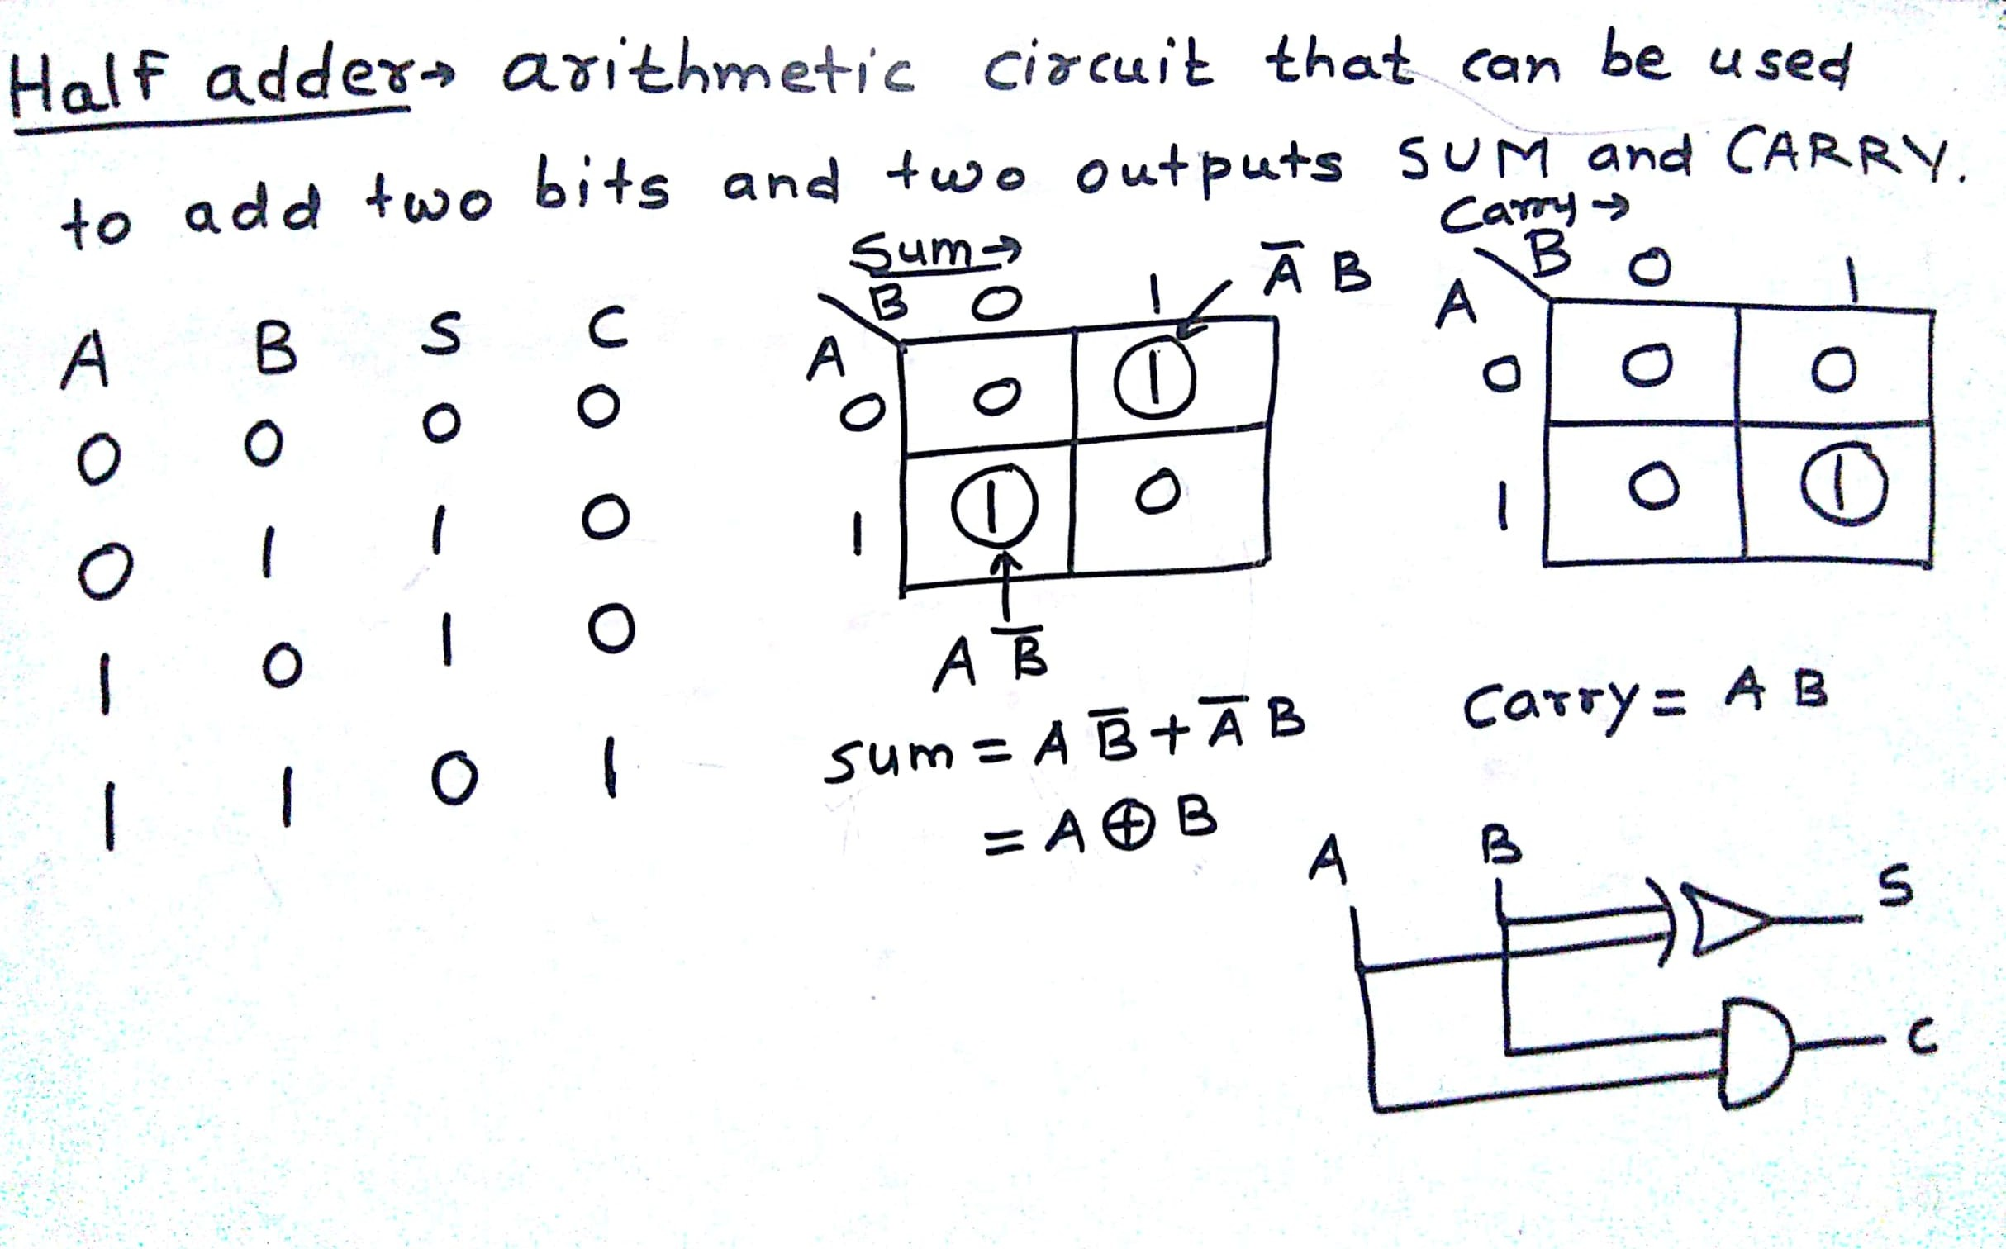

Half Adder
Department of Computer Engineering

Slide 5
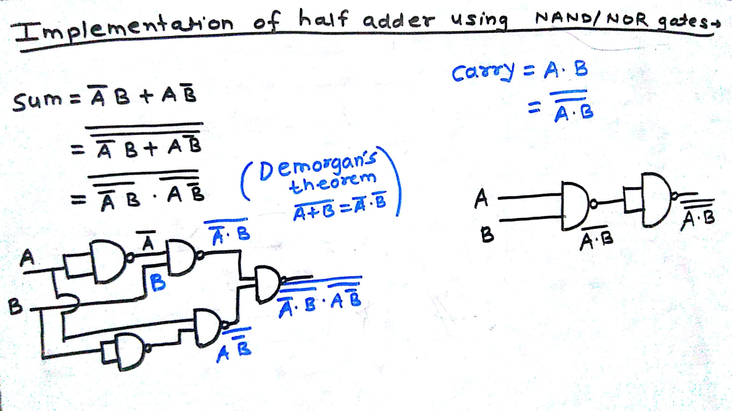








Half Adder
Department of Computer Engineering

Slide 6
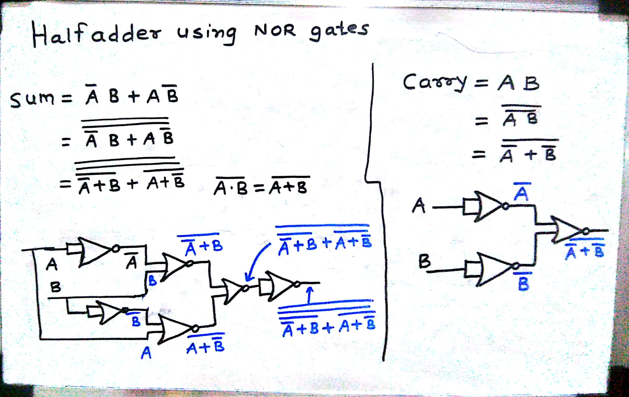
Half adder
Department of Computer Engineering

Slide 7
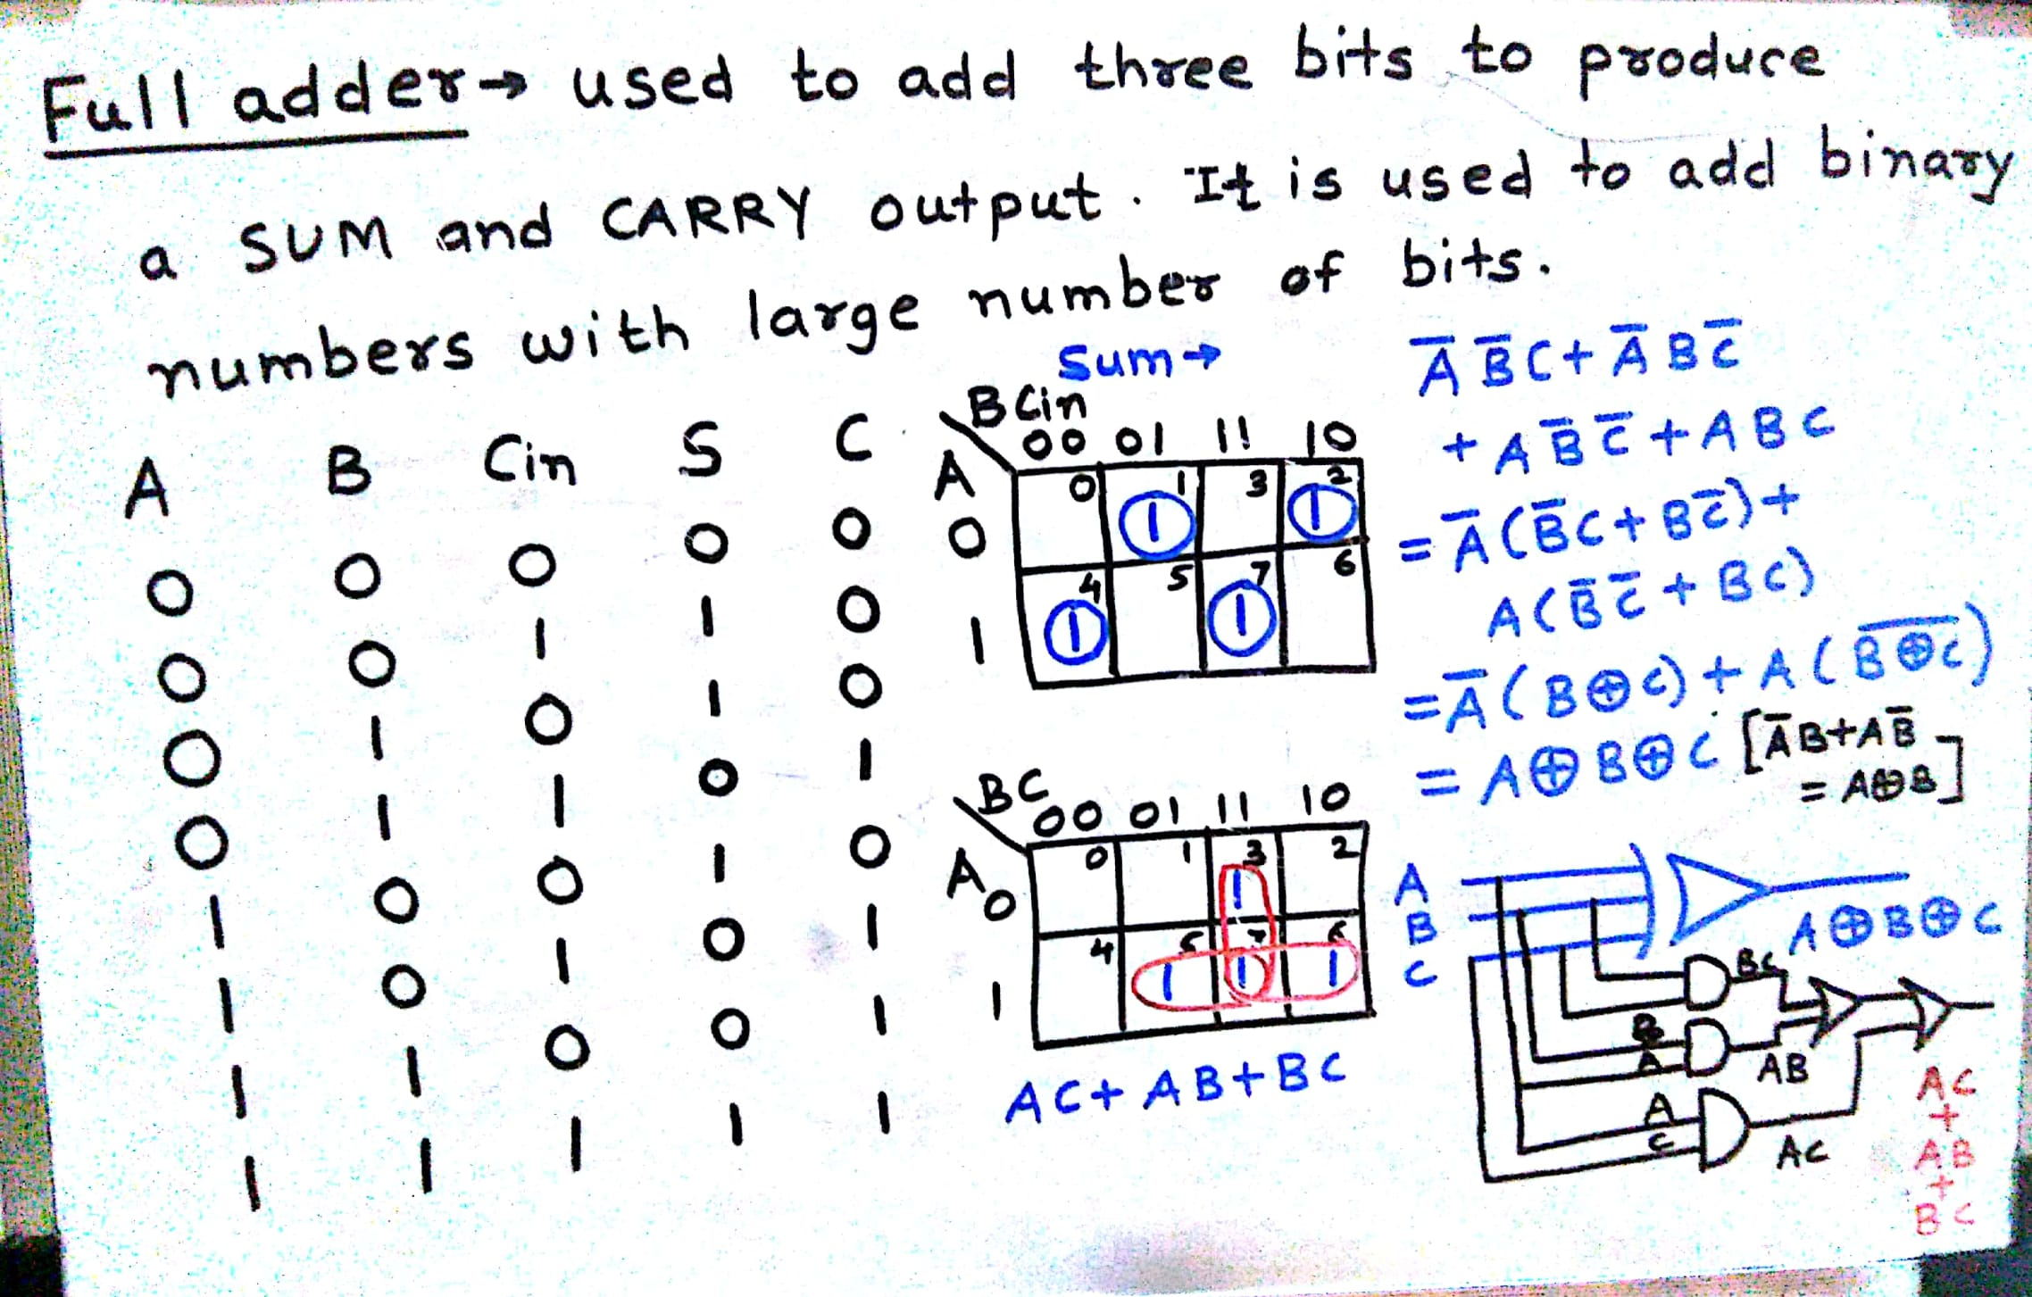








Full Adder
Department of Computer Engineering

Slide 8
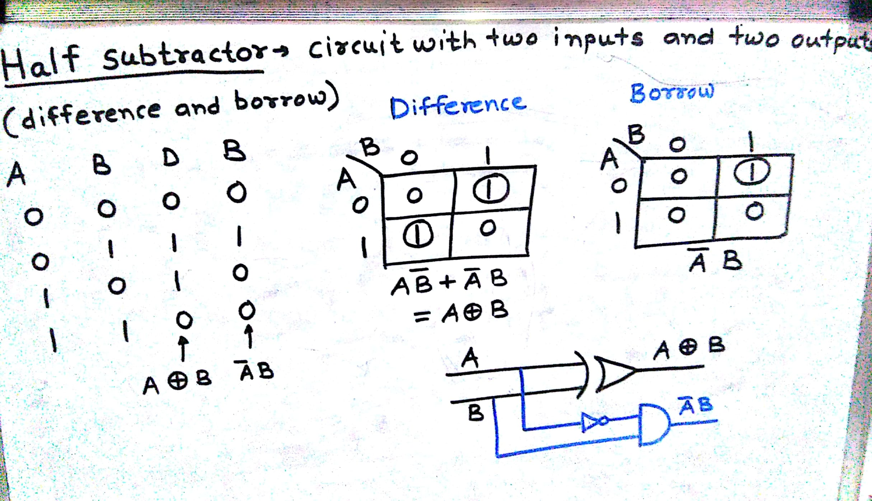
Half Subtractor
Department of Computer Engineering

Slide 9
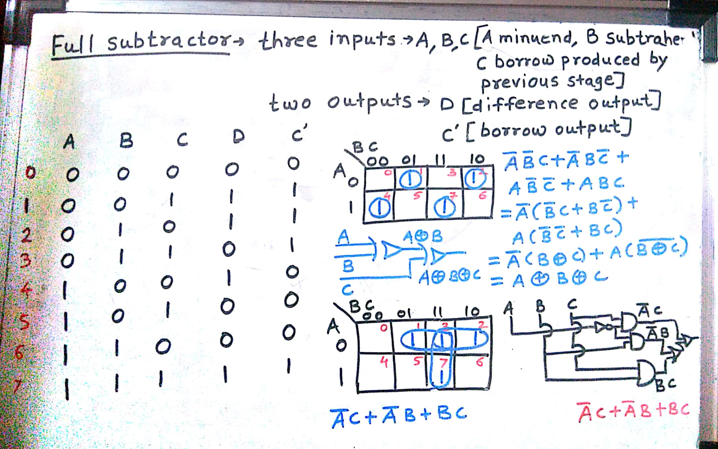

Full Subtractor
Department of Computer Engineering

Slide 10
Diff | B | A | B | C | Diff | Borrow
0 | 0 | 0 | 0 | 0 | 0 | 0
0 | 0 | 0 | 0 | 1 | 1 | 1
1 | 1 | 0 | 1 | 0 | 1 | 1
1 | 1 | 0 | 1 | 1 | 0 | 1
1 | 0 | 1 | 0 | 0 | 1 | 0
1 | 0 | 1 | 0 | 1 | 0 | 0
0 | 0 | 1 | 1 | 0 | 0 | 0
0 | 0 | 1 | 1 | 1 | 1 | 1

Slide 11
Quiz
Please click the following link to open the quiz
testmoz.com/4374660

Slide 12
Points covered
Department of Computer Engineering
Half adder
Full adder
Half Subtractor
Full Subtractor
Quiz
12

Slide 13
Department of Computer Engineering
Thank you

